Slide 1
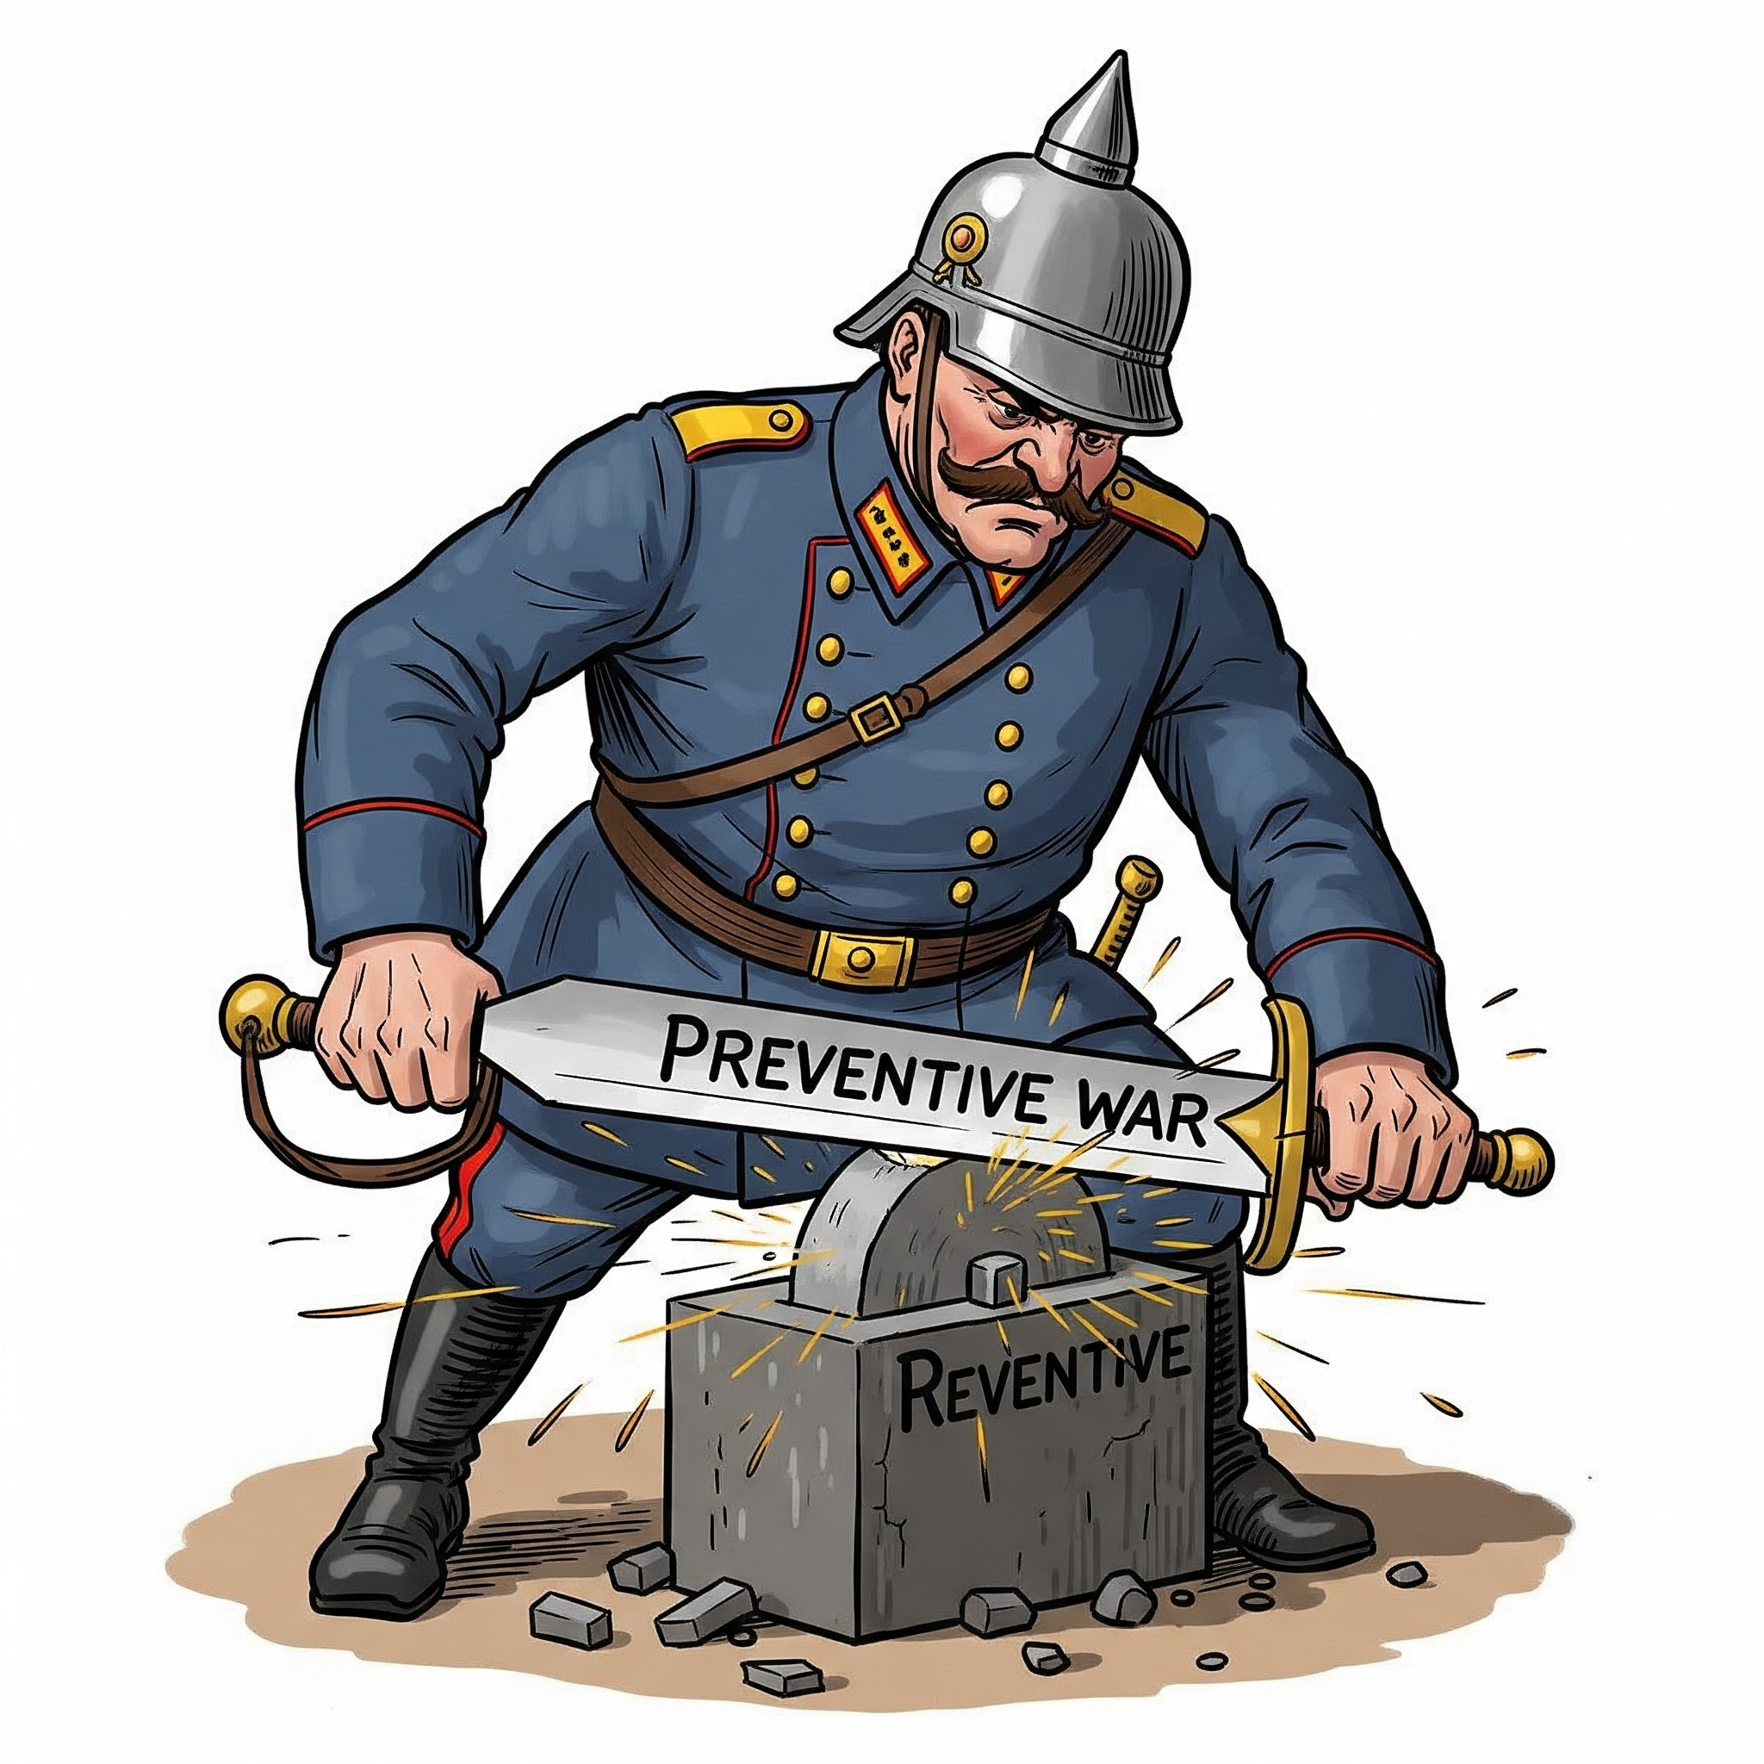
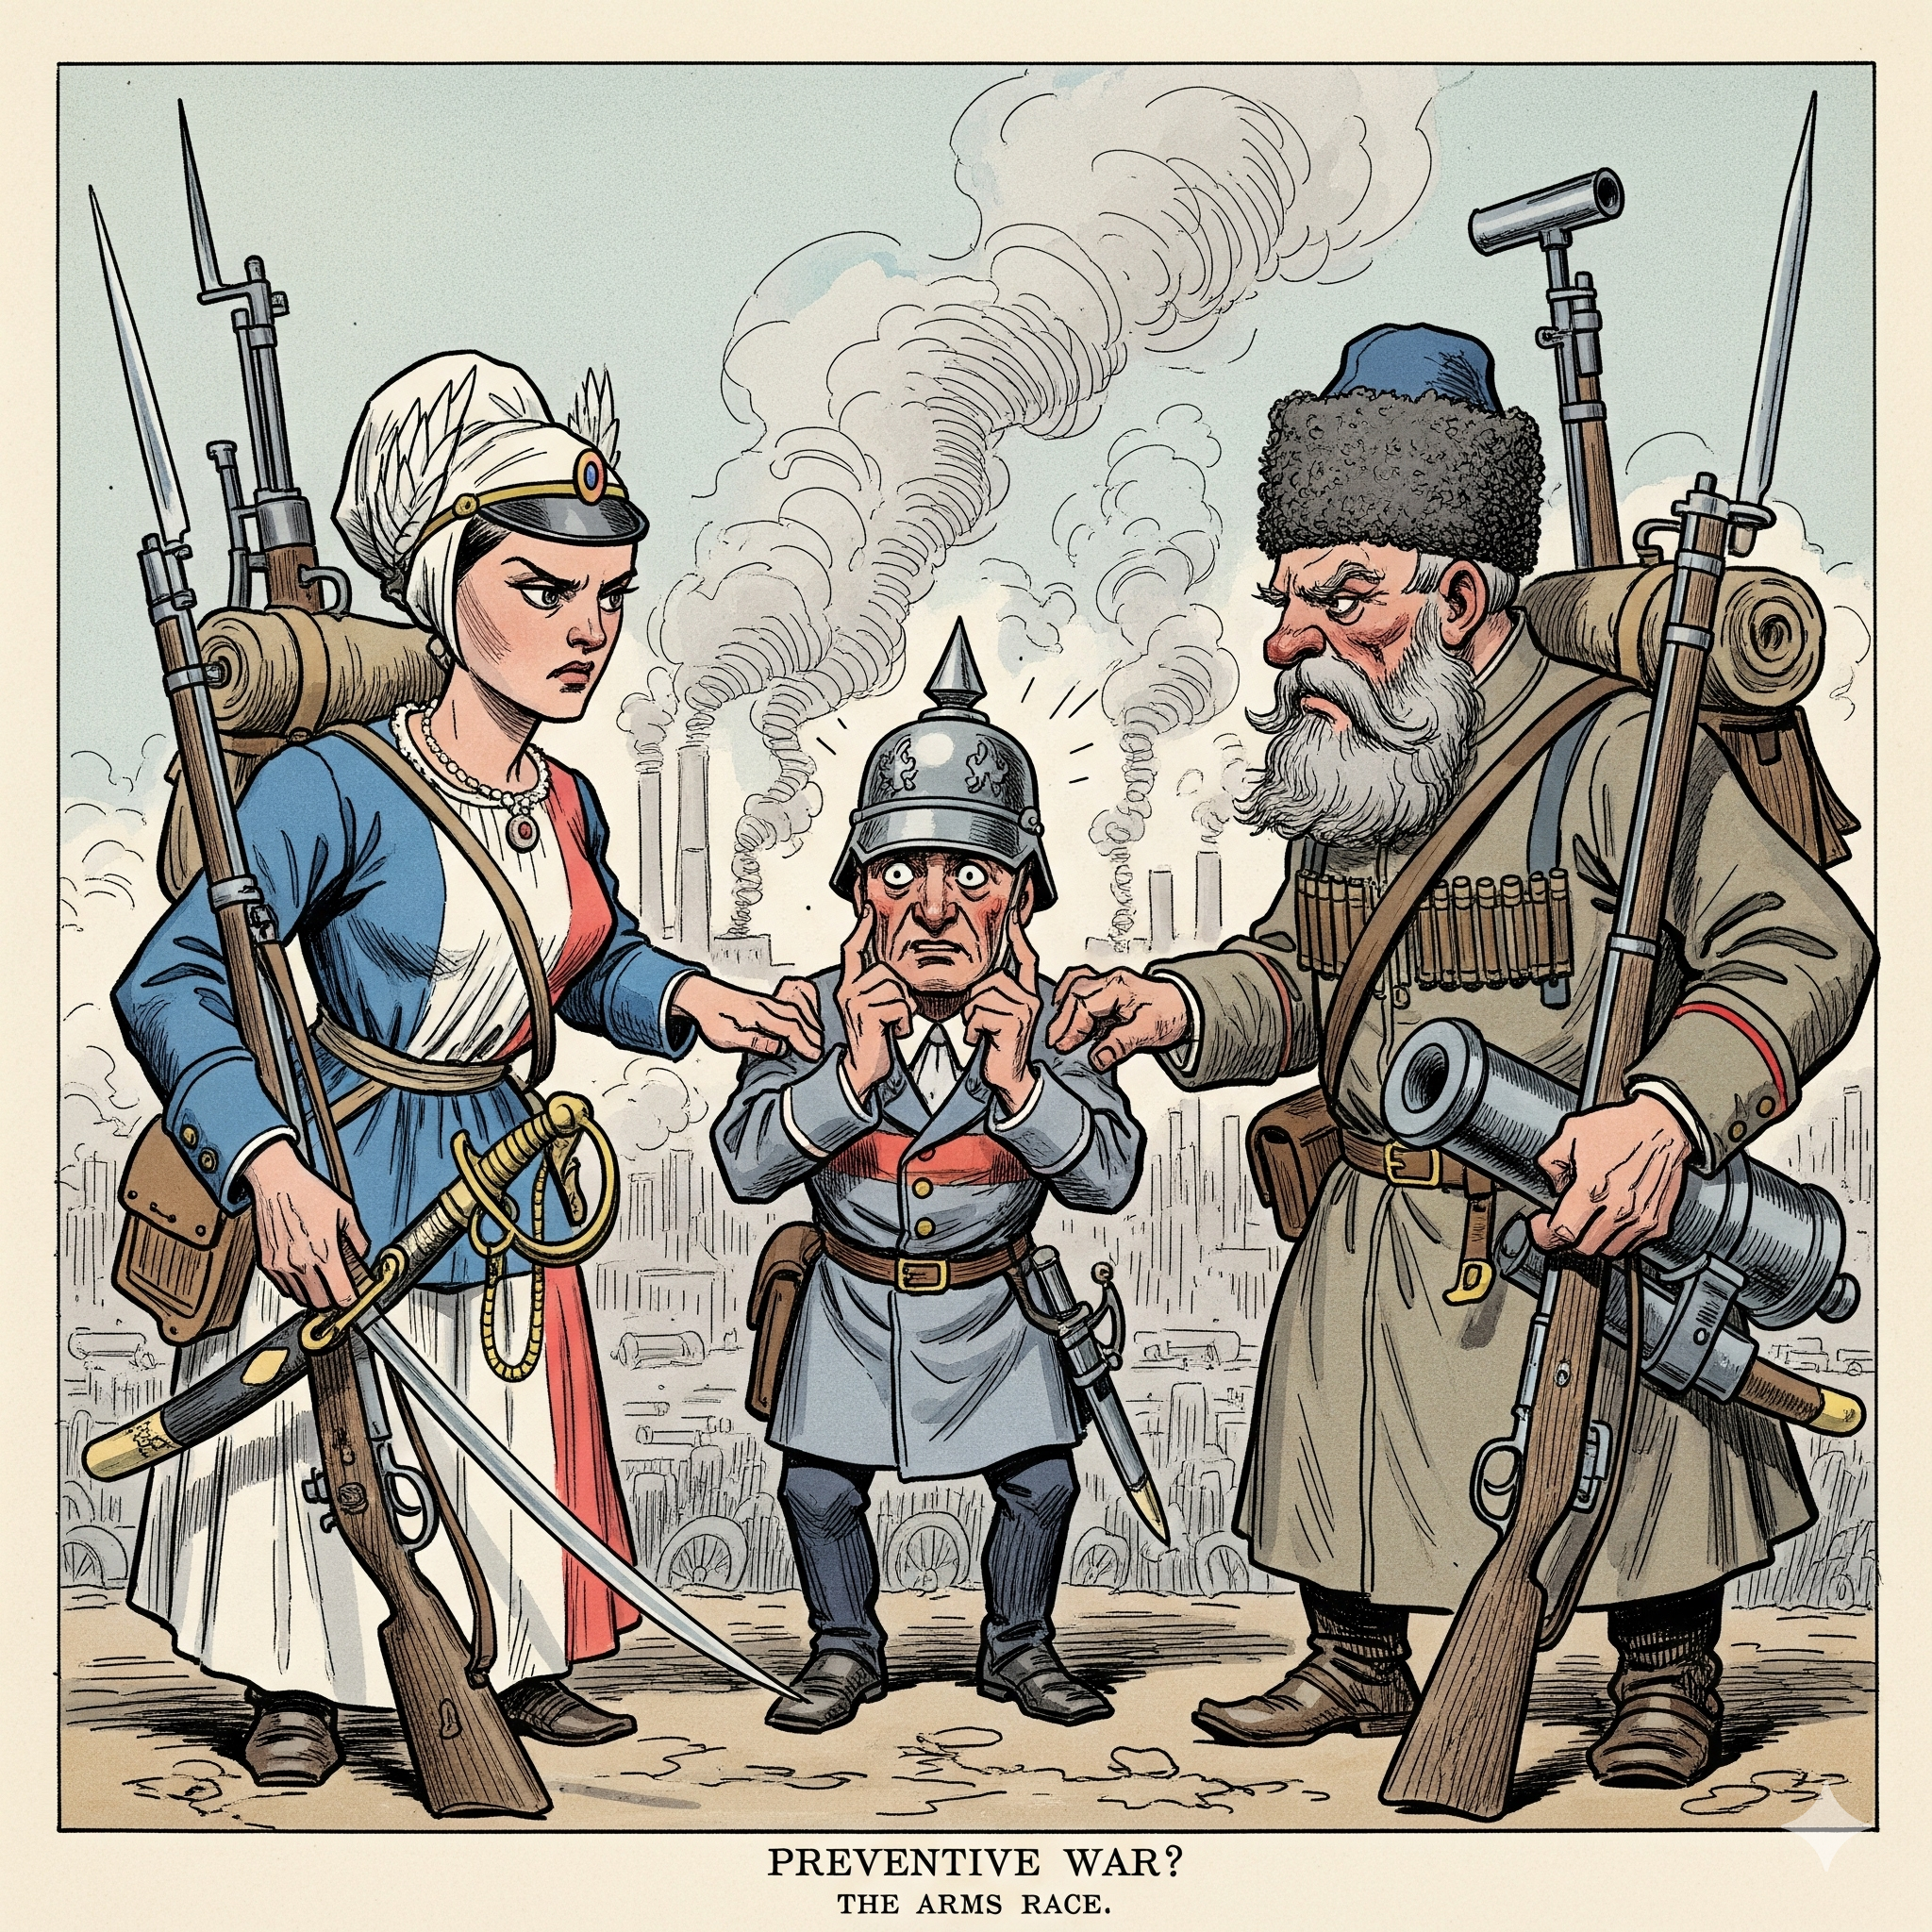
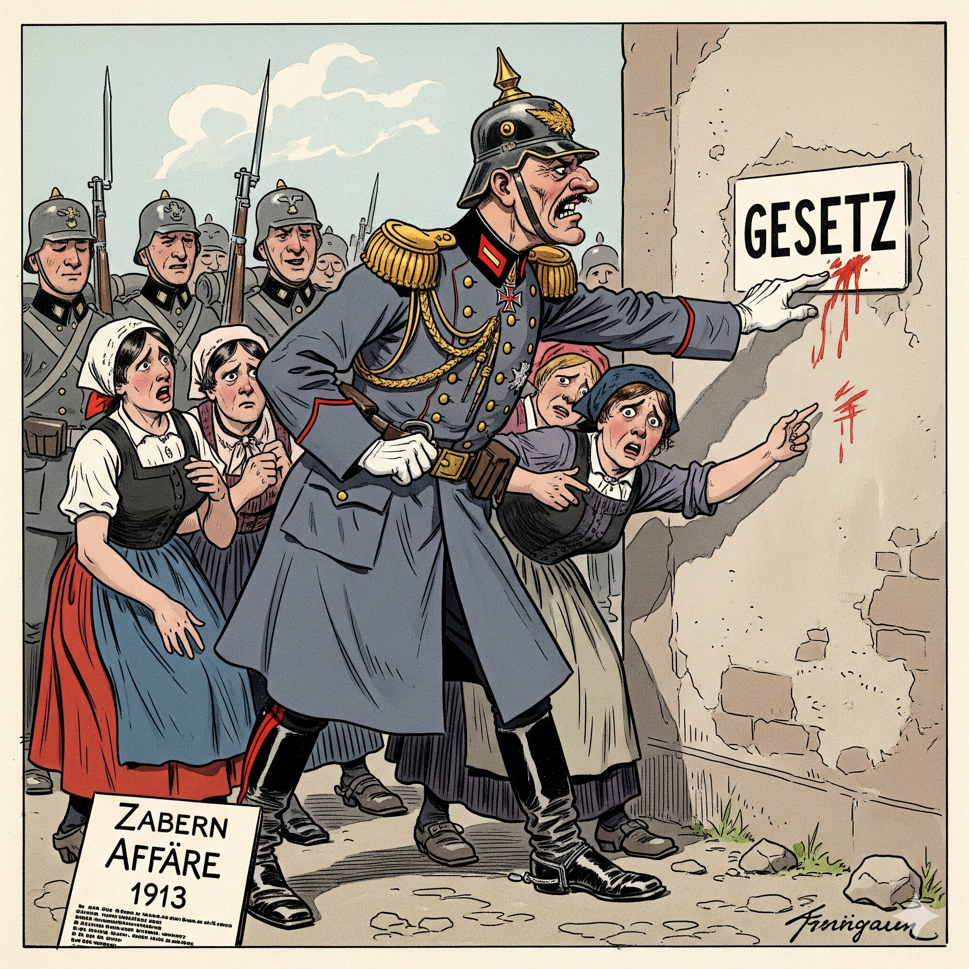
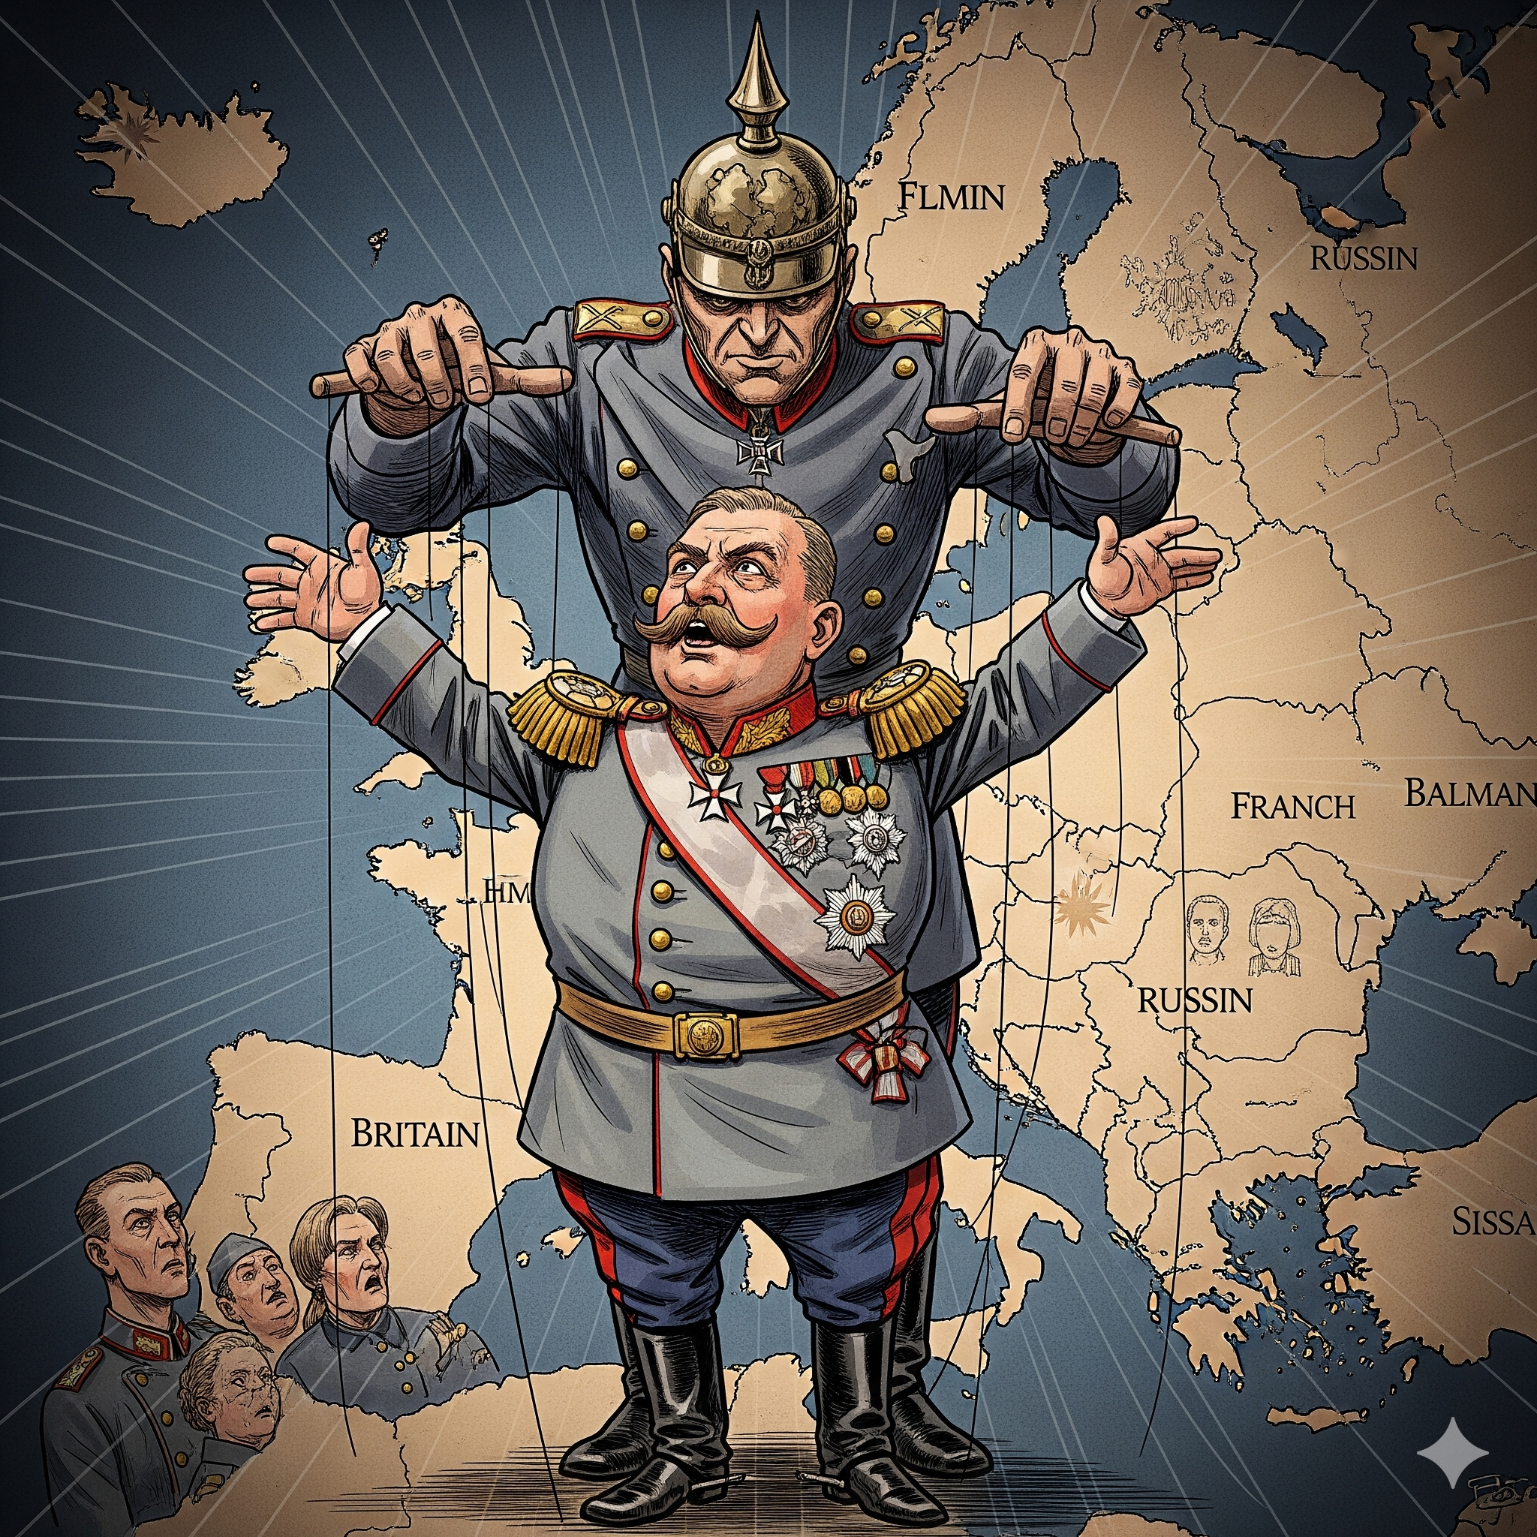
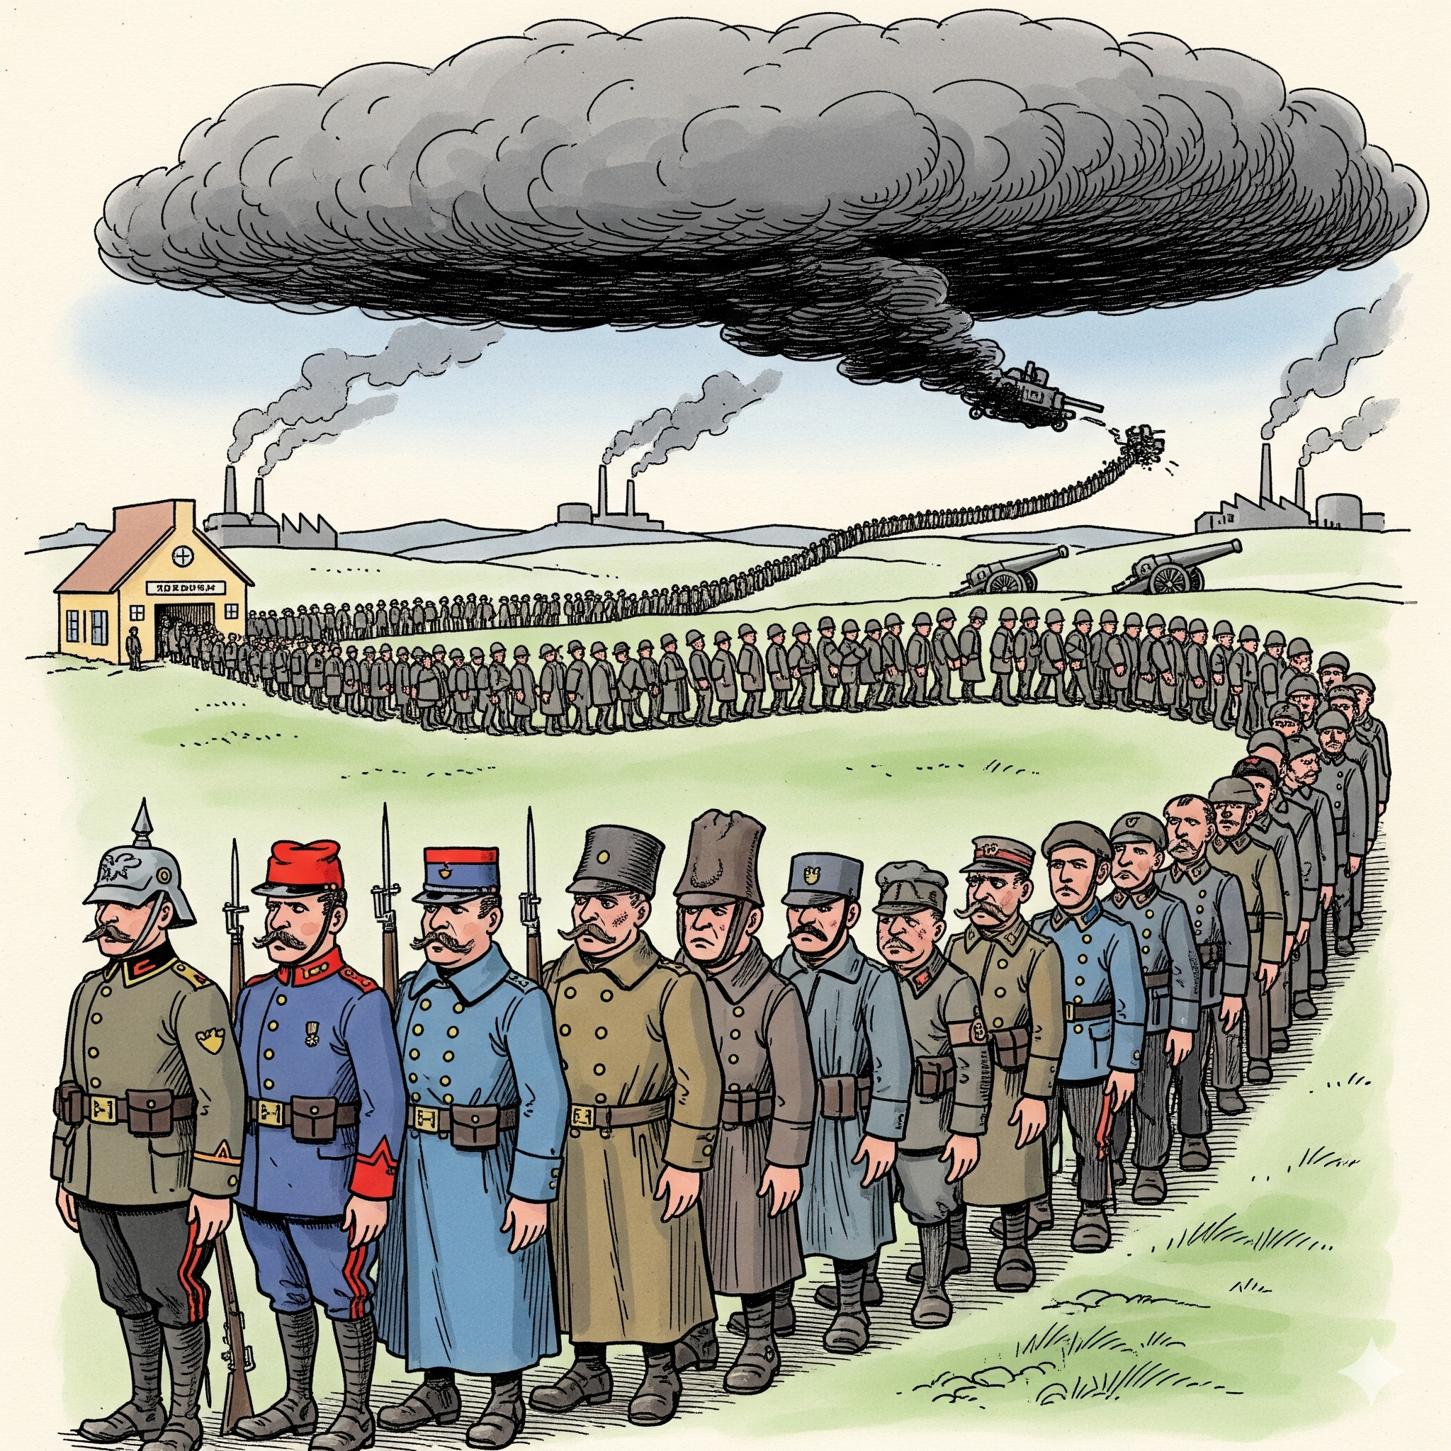
Germany’s Militarism and Preventative War
In 1914, Germany planned to use preventive war, which means attacking first to stop others from attacking them. This strategy actually made war more likely, because other countries saw the threat and started preparing their armies, making an arms race worse.
Germany was worried about being surrounded by strong neighbors like France and Russia, especially since Russia was modernising its army with help from France. Thinking war was unavoidable and time was running out, Germany’s use of preventive war increased tensions in Europe.
Germany’s militarism under Kaiser Wilhelm II showed how aggressive the country was. The Zabern affair in 1913, when a German officer in Alsace treated civilians badly without punishment, showed how powerful the military was. The army could act on its own, even breaking the law.
Unlike in France and Britain, where governments controlled the army, Germany’s leaders allowed the military to act independently. Combined with Wilhelm’s impulsive and undiplomatic behaviour, Germany’s focus on preventive war was a major reason Europe moved closer to World War I.
The Arms Race
Before WWI, European countries used a system called conscription, which meant men had to serve in the army for a set amount of time. This gave the main powers in Europe large, trained armies. In the years leading up to the war, France and Russia made men serve for longer, which made their armies even bigger. Germany also passed new laws to increase the number of soldiers in its army.
These armies could grow much larger in wartime. Most countries kept big groups of trained men in reserve, ready to be called up if needed. This meant that during war, countries could increase the size of their armies by as much as four times, creating a huge military force across Europe.
Glossary
Preventive war – Attacking first to stop others from attacking you.
Military – The army, navy, and other armed forces of a country.
Impulsive – Doing things quickly without thinking carefully.
Diplomatic – Being careful with words and actions to keep good relations between countries.
Undiplomatic – Saying or doing things in a way that upsets others or causes problems between countries.

Slide 2
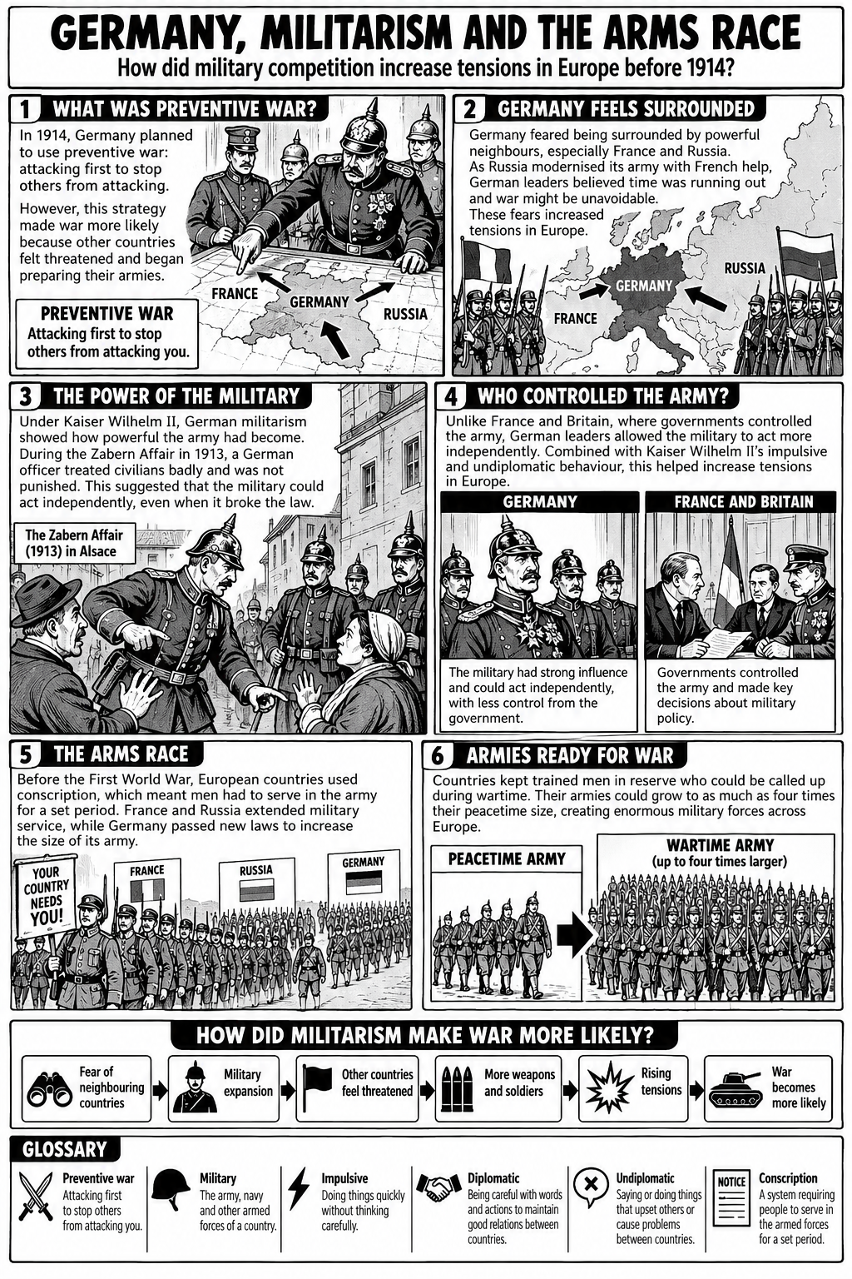

Slide 3
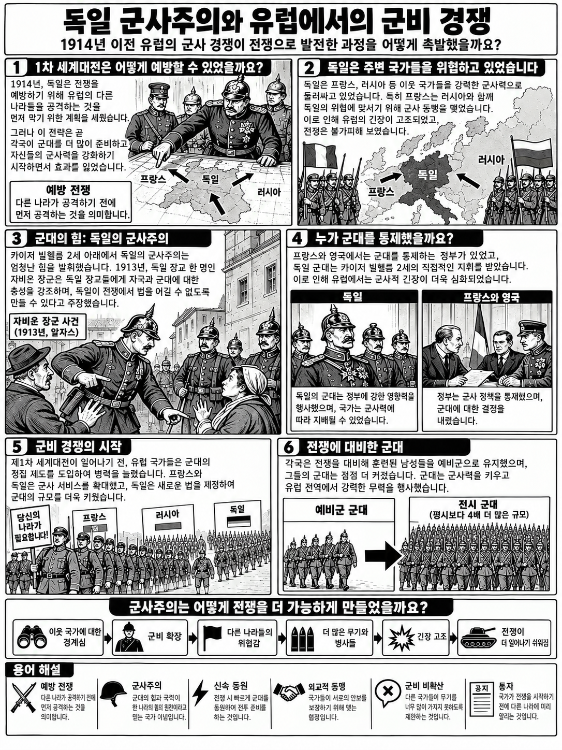

Slide 4
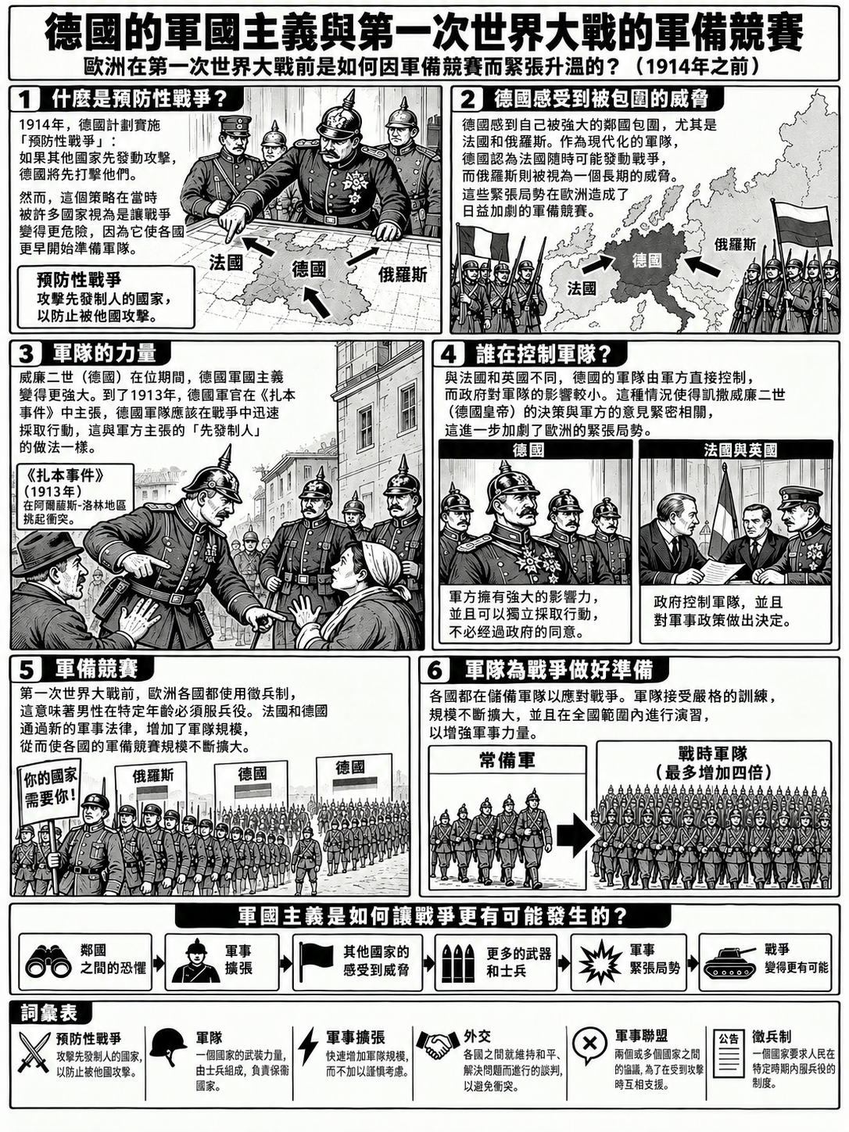

Slide 5


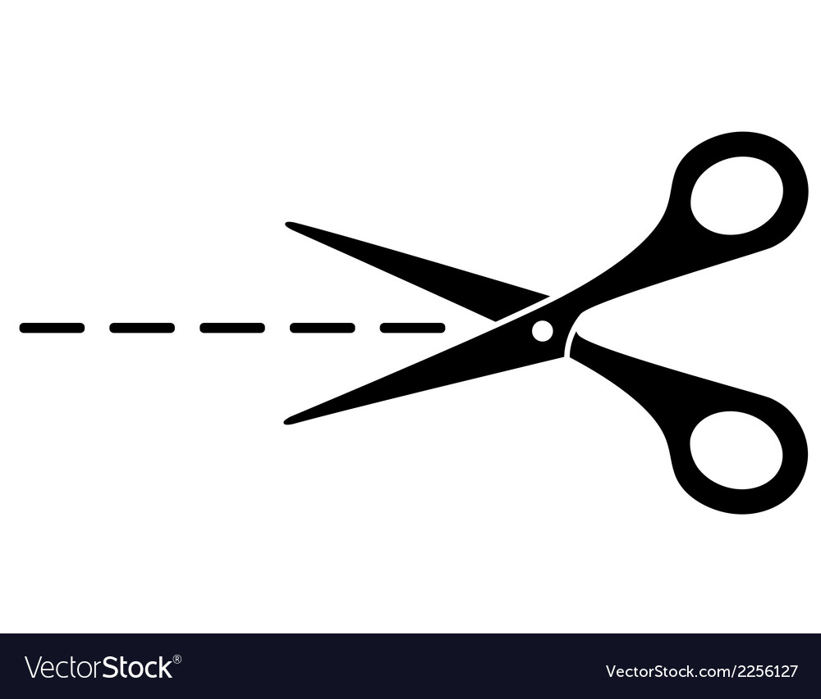
Germany’s Militarism and Preventative War
1. In 1914, Germany planned a preventive war, which meant ___________________________
___________________________________________________________________
2. Germany feared being surrounded by France and Russia because ____________________
______________________________________________________________________________________________________________________________________
3. The Zabern affair in 1913 showed that ________________________________________
______________________________________________________________________________________________________________________________________
4. Unlike France and Britain, Germany’s military was ________________________________
___________________________________________________________________
5. Kaiser Wilhelm II’s impulsive and undiplomatic behaviour meant that __________________
___________________________________________________________________
Army and Navy numbers of the main powers before WWI – shown in thousands
Country | 1890 | 1914 | % increase 1890 - 1914
Russia | 677 | 1352 | 99.7%
France | 542 | 910
Germany | 426 | 891
Britain | 367 | 532
Aus-Hung | 246 | 444
Italy | 216 | 345
Japan | 71 | 306
USA | 34 | 164
% Change = (1914 number - 1890 number) / 1890 number x 100
Change = 1352 - 677 = 675
Original starting number = 677
(675 / 677) x 100 = 0.997 x 100 = 99.7% (Round Up!)
Germany, France, and Russia show bigger percentage increases because _________
___________________________________________________________________________________________________________________________________________________________
Percentage change helps us understand the data because _____________________
_____________________________________________________________________________________________
The arms race made tensions in Europe worse before WWI because ______________
____________________________________________________________________________________________________________________________________________________________________________________________________________________________________________________

